Slide 1

Newsletter
October 2025
Great products for you

Slide 2




agenda
Company News
New Catalogues
Social Media
Shops Available
Buying Online
Forecasts
Christmas Launch
Availability
Houseproud
Health & Beauty
Pet Care
Prime Care
Green Living
Living Spaces
Latest Products
Other Updates
Buy anywhere you want
3 Websites filled with products

Slide 3

Forecasts
Christmas Launch
Availability
Updated Catalogues such as Houseproud and Health & Beauty. All with new products and replacements.
Christmas Launch in September with 100 and 100 of products including bestsellers of Christmas 2024. All available now.
Availability of products. Products are available at 95% or above stock. Selling out products can be replaced with similar ones.
VivaMK

Slide 4

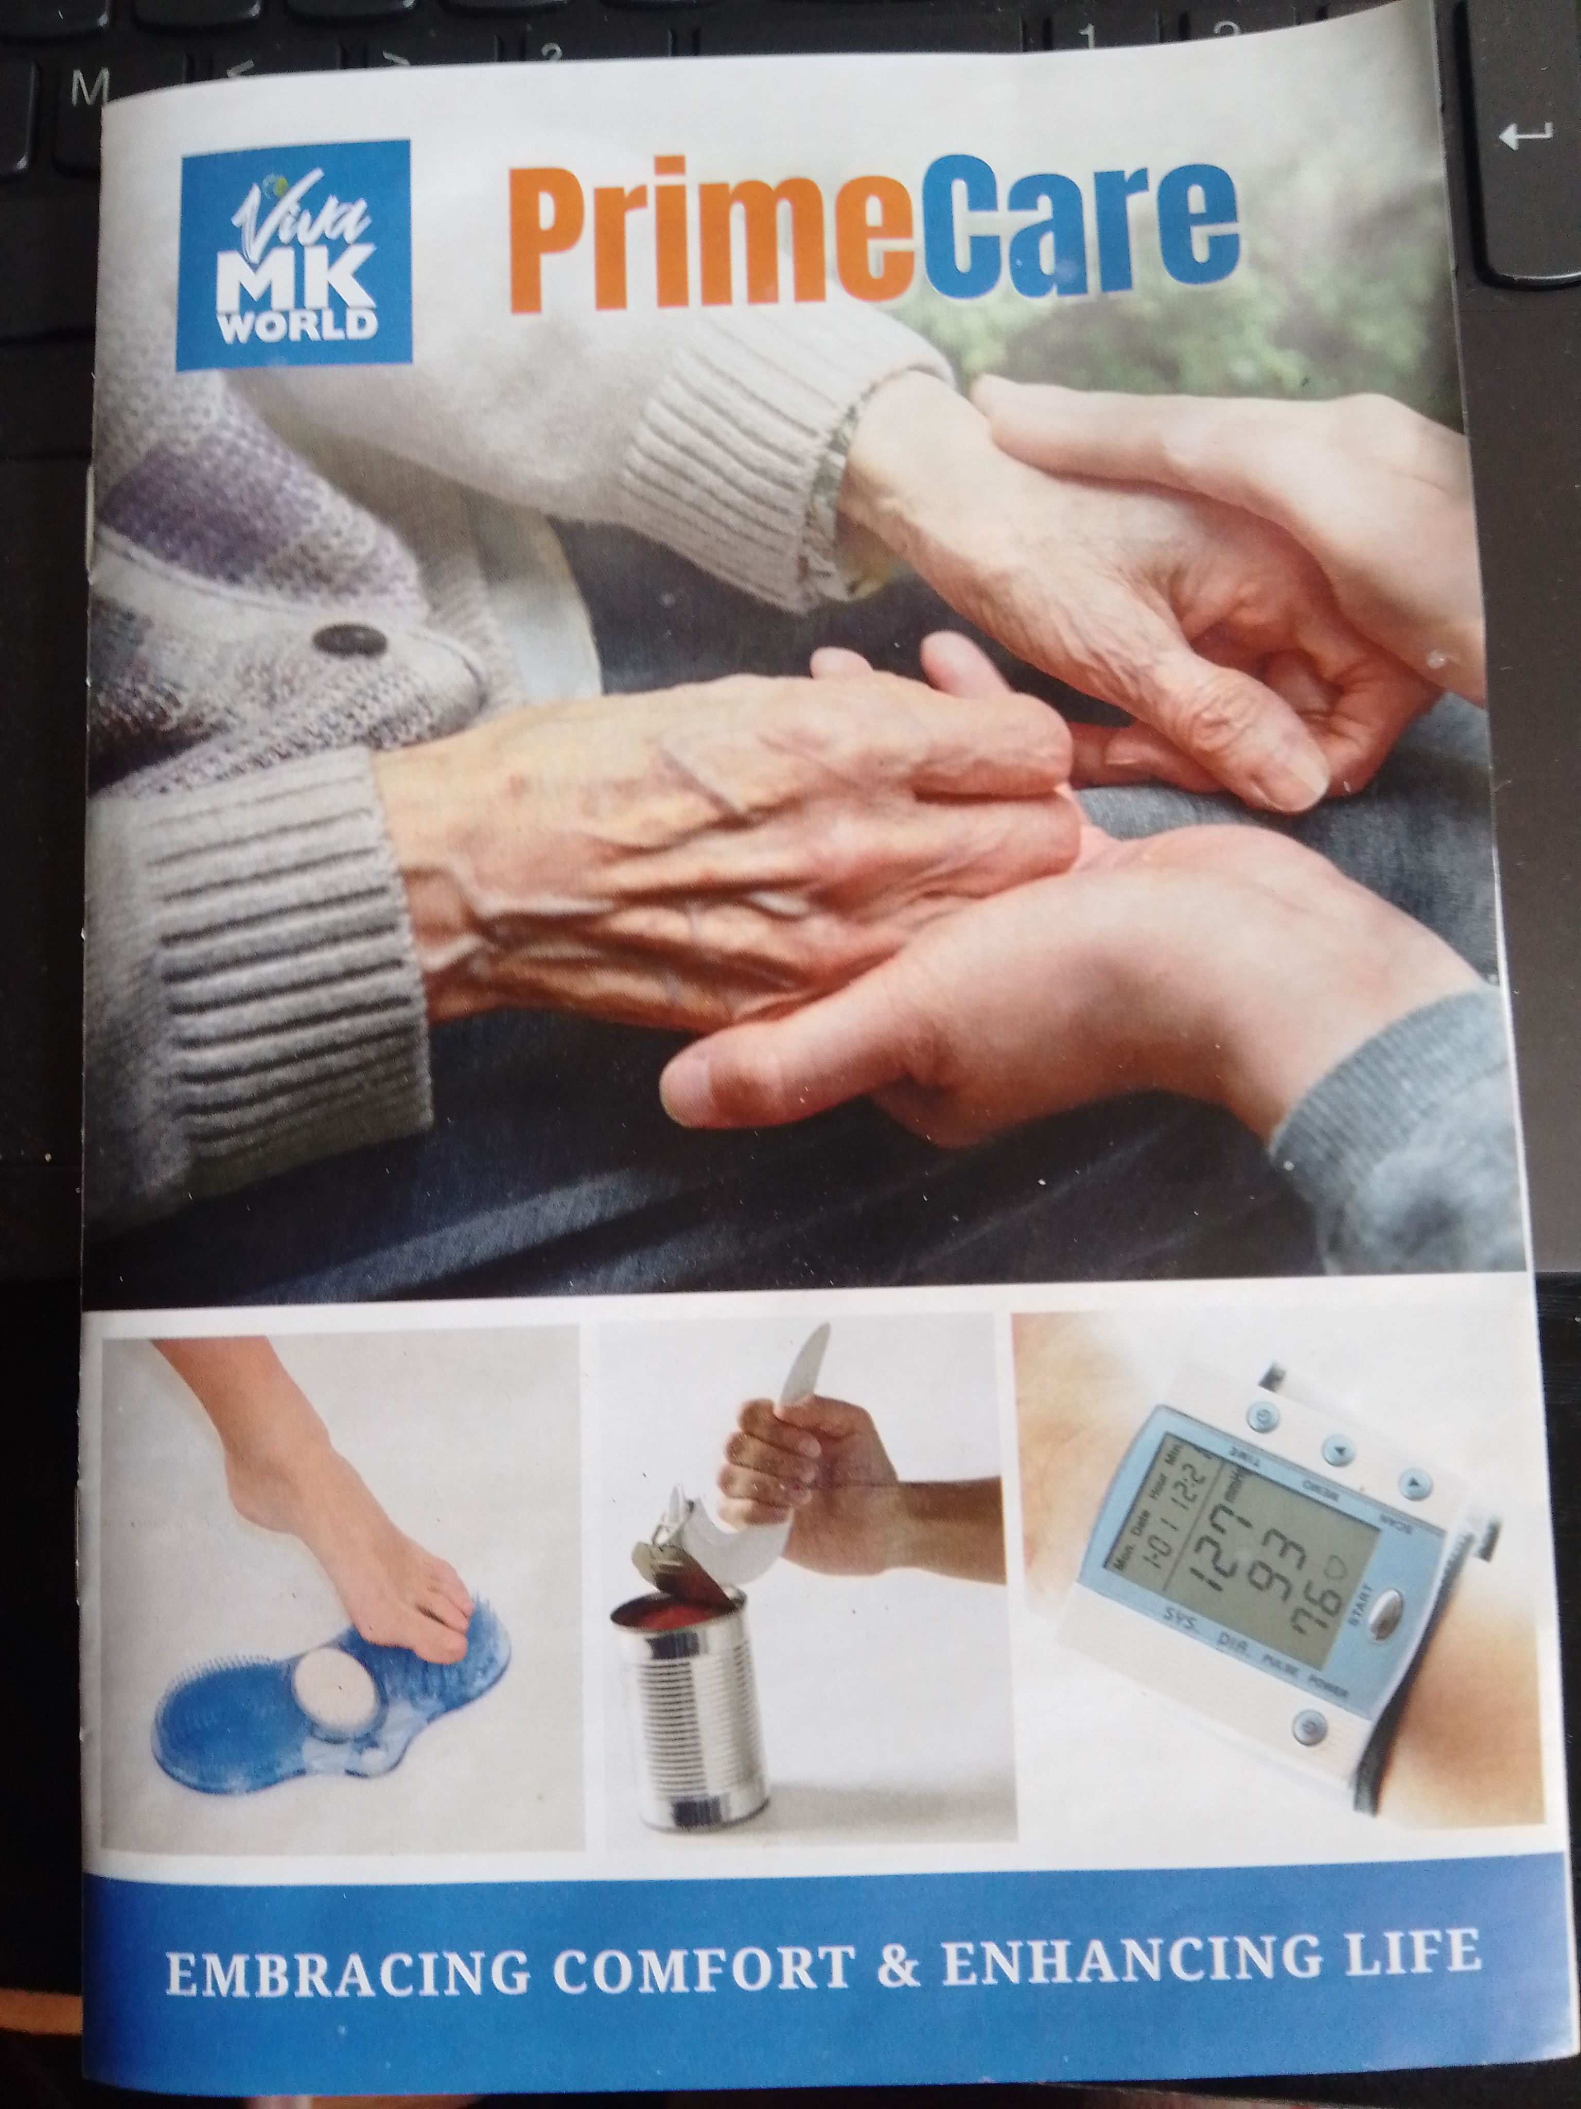






Product Line
HouseProud
Health & Beauty
Pet Care
Prime Care
Green Living
Newly Updated
Newly Updated
Brand New Catalogue
New Catalogue on it’s way
New Catalogue on it’s way

Slide 5



Social Media
Follow on social media
Engage in viewing the latest and most popular products.
TikTok
Instagram
Pinterest
Tiktok Social Media
Tiktok Shop
Social Media
Social Media

Slide 6


Product
Amazon Shop
eBay Shop
Presently Growing
Increasing
Seller Platforms
Your Shops.
Tiktok Shop
Great Products For You
Greatproductsvivamknetwork
Greatproducts.vivamknetwork.co.uk
Still Growing
Continuously Updated

Slide 7

Christmas with 4 catalogues
Browse for the best gifts, décor, cards, wrapping, lights..

Slide 8

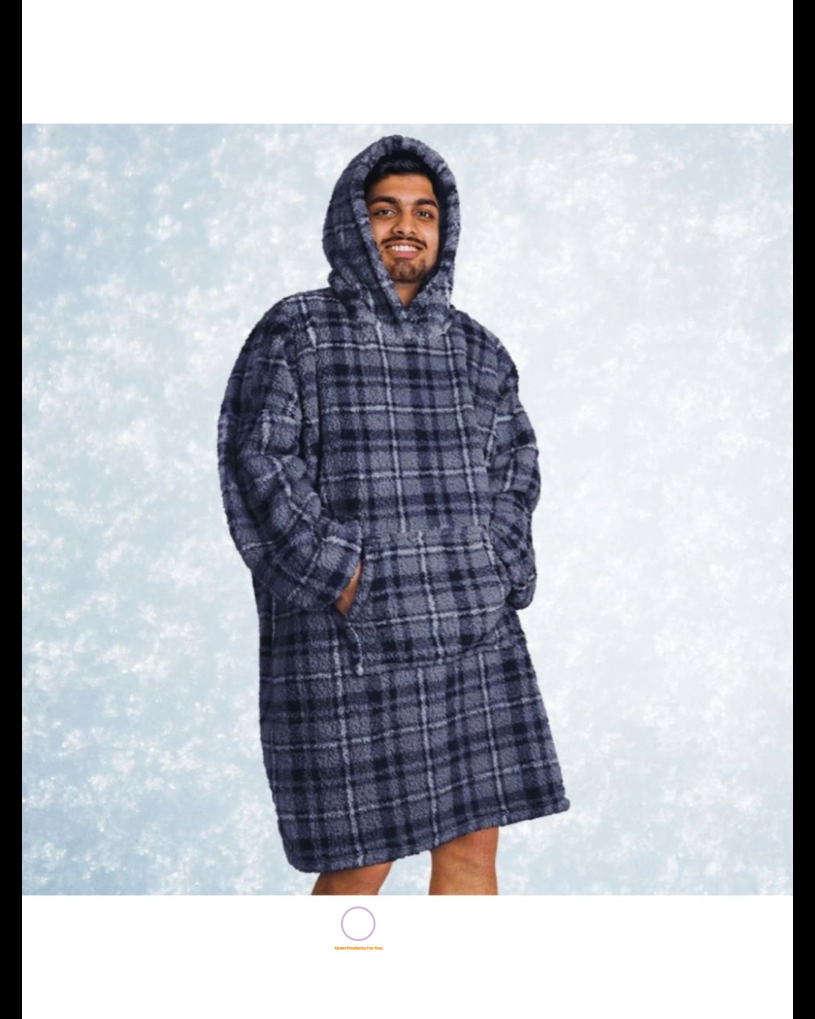

Great products for you
Thank you for your orders. I have great pleasure in serving you and find a smile I never forget.

Slide 9




Thank you
Margit Enzenmuller
+44 01483 456 098
margit@greatproductsforyou.co.uk
www.greatproductsforyou.co.uk

