Slide 1

Welcome to our newsletter
Great Products For You

Slide 2
Agenda
Review of the past
Building confidence
Engaging the audience
Visual aids
Final tips & takeaways

Slide 3

Looking at the past few months we have introduced many new products across the spectrum. Pet supplies, bedding already for Christmas & other, more household products, new lipsticks with glows totally vibrant, outdoors with décor incomparable to anywhere, increasing products in prime care most of all wellness products for summer and during the year.

Slide 4

We are now ready to launch our Christmas Collection of 4 books on 1st September 2025 and even started already the Christmas collection for 2026
It could be the biggest Christmas offer we ever had. We also sold well Christmas products still available during the year.
We are also launching a dedicated pet catalogue for our customers with many products online.
Pet Sprinkler Splash Pool

Slide 5
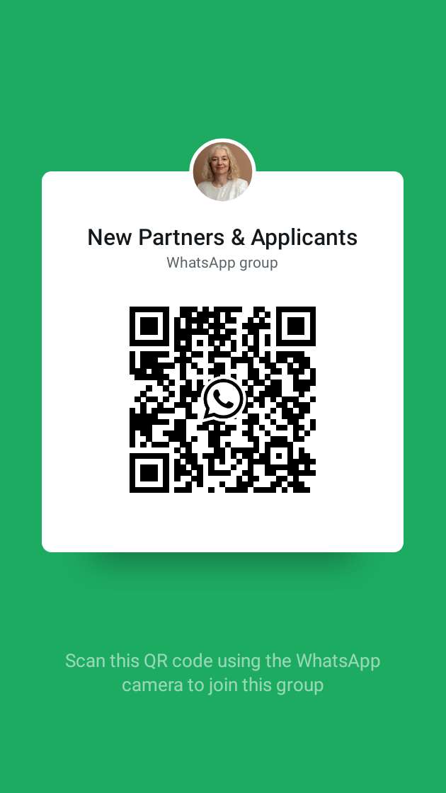
Engaging the audience
I will be setting a group for my customers on WhatsApp and also a community as we have been in the past participating in such the Kleeneze Community Project. So all customers can engage for orders or social. I have access given for mobile/computer classes which we can include the community. I hope that customers will participate. I have a group for members who want to engage online. This is open to anyone without restrictions as long as the usual online guidance is observed.
Groups | Great Productsforyou

Slide 6
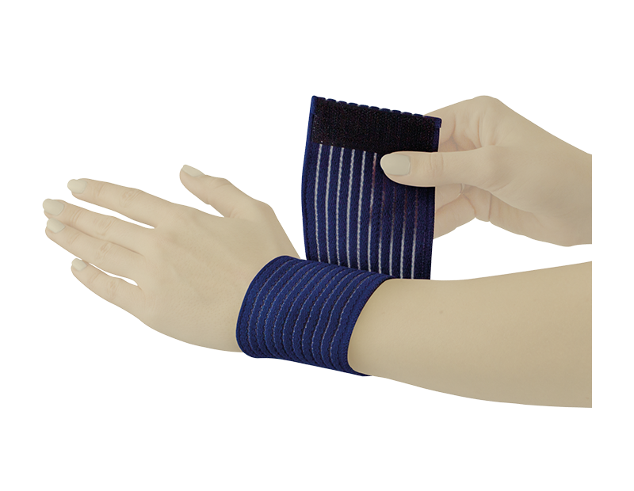


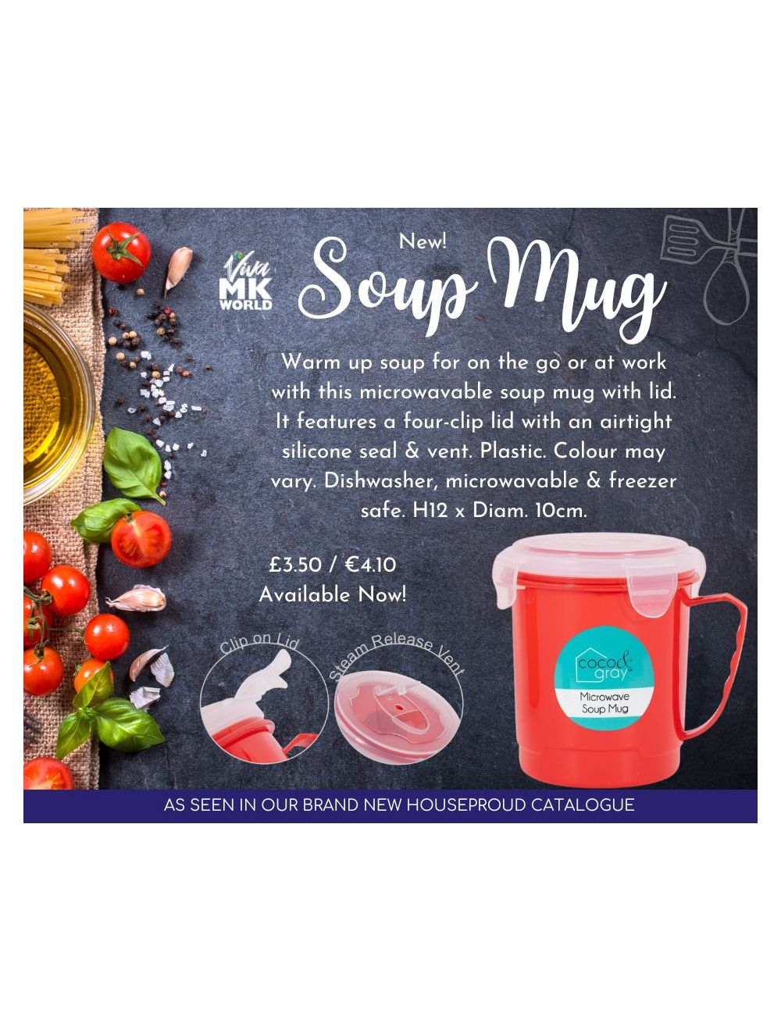
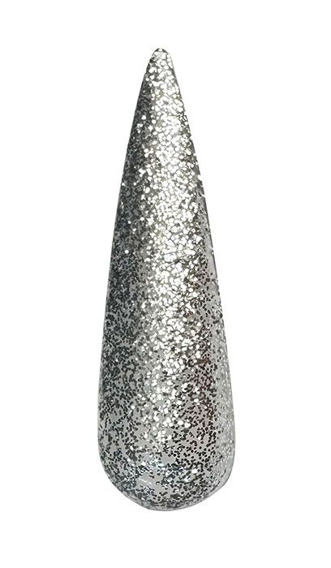
www.greatproductsforyou.co.uk www.greatproductsvivamknetwork.co.uk

Slide 7

Advertising requires content creation and in many times creating a video for buyers.
Social media offers many product displays which can enforce brand awareness, orders, a buying tool for customers like balancing price & quality, introduction to new solutions & also company displays.
www.greatproductsforyou.co.uk
My New Channel

Slide 8

What to look out for now
The ongoing sales which is offered online. Christmas is generally low on sales. Local customers are entitled to apply for the online discount whilst getting free delivery. The option of taking out an account to benefit from big discounts at any time.

Slide 9

Thank you
Margit Enzenmuller
07807317371
01483456098
margit@greatproductsforyou.co.uk
www.greatproductsforyou.co.uk

