Slide 1

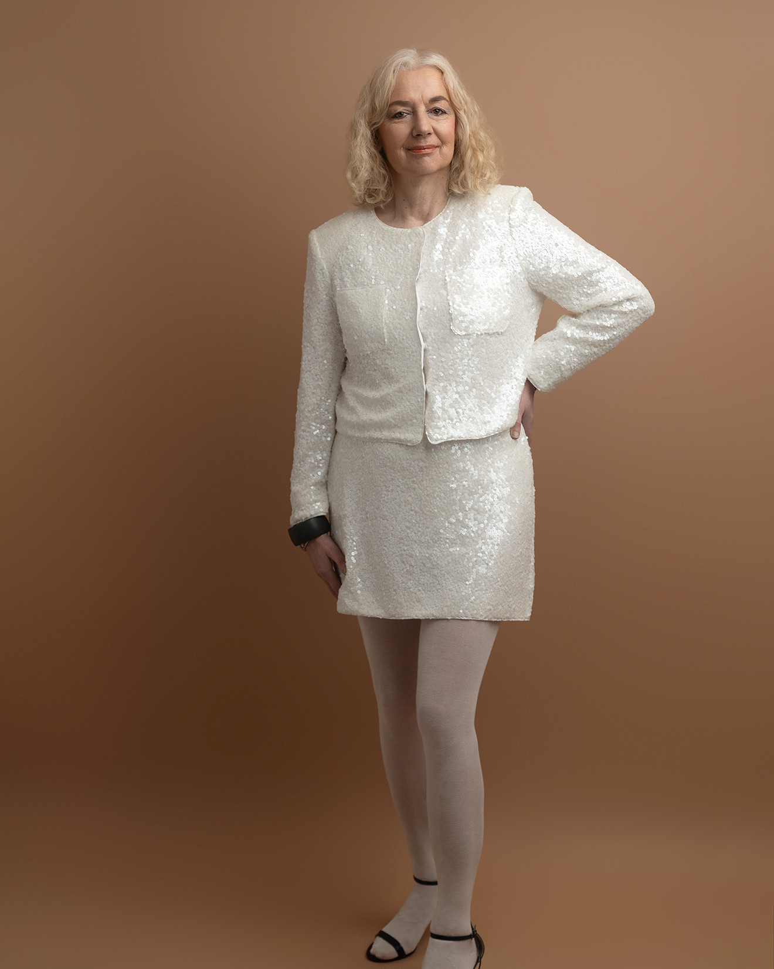
Newsletter
June 2025
Margit Enzenmuller

Slide 2
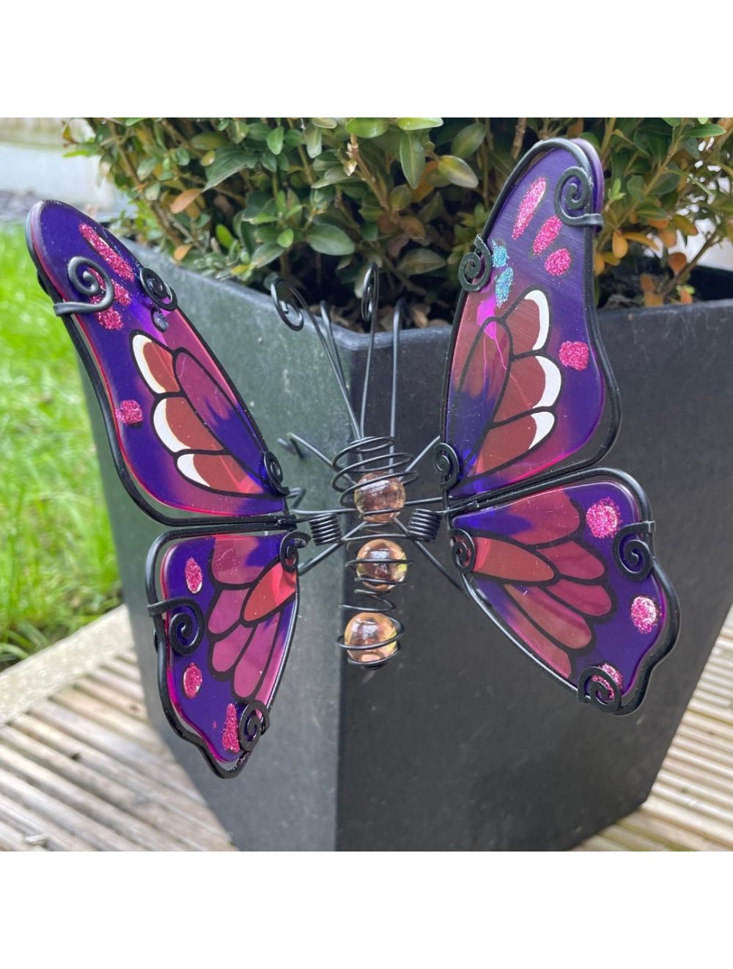
Agenda
News For Customers
Sales
Enhanced Personalised Products
New Outdoor Garden Catalogue
New Starter Programs
New Free Mobile/Computer Classes
New Free Business Events Booking

Slide 3

News For Customers
We have added more catalogues to our range. A greater choice and combined personalised products & gifts. Our petals & paws catalogue features everything you need for outdoors & garden. House Proud is now updated and provides many new essentials for your home. We have a new smaller weave & wonders booklet to show you our classic bedding sets. This is all going along with our revised beauty & skincare book.

Slide 4

Sales
Our perfume edition is selling fast and more fragrances will be added. Our face facts serums are extremely popular. Home essentials are repeatedly ordered. So do not hesitate to call for reorder.

Slide 5
Personalised Range
 | Journal | Mugs | Thermal Flasks | Water Bottles
 | Tool Kits | Glass Case | Cufflinks | Secure Credit Card Holder
 | Pens & Pencils | Magnetic Puzzles | Pencil Cases | Art Box
 | Mobile Phone Bags | Compact Mirrors | Jewellery | Lights & Ornaments
 | Cushion Covers | Pet Tag & Lead | Secateurs | Outdoor Mail Box

Slide 6
Sales Periods For Starters
Mentor Program For Starters and Newcomers
Michael Khatkar

Slide 7
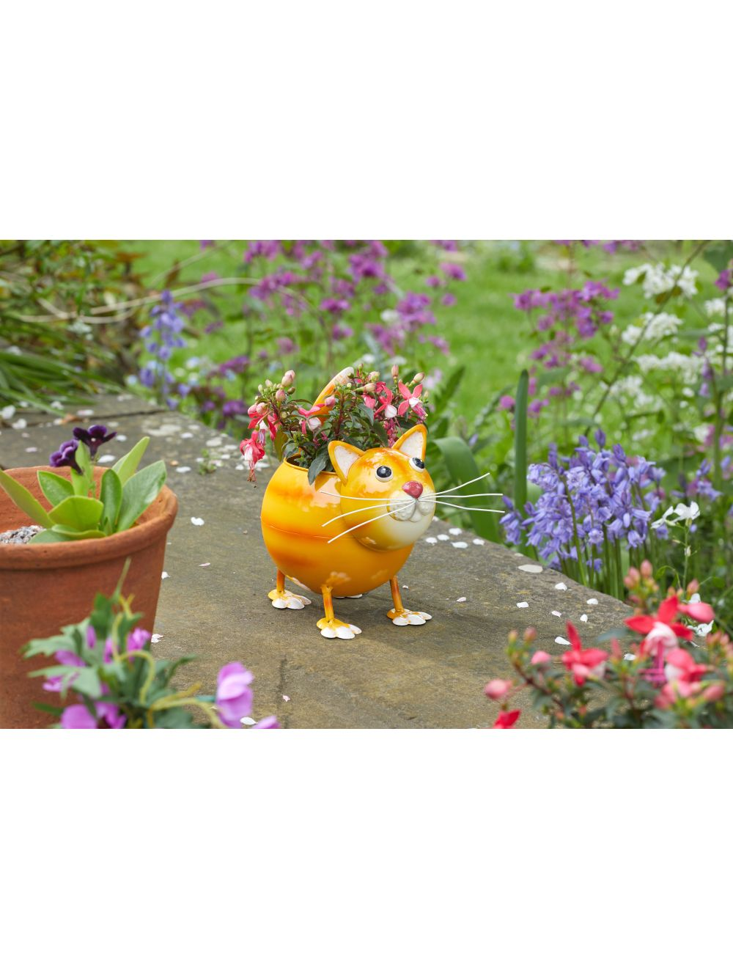
New Outdoor Garden Catalogue
Weed Killers, Garden Gloves, Tidy Box, Comfi Kneeler, Watering Can, Shears, Pathway Fencing, Tap Jacket as Ever, Storage Bag, Seedballs specifics – Read, Coir Mats, Garden Table, Balloon Lights, Solar Lights, Planters & Ornaments, Cleaners & Disinfectants, Mouse Traps, Wasp Repellent, Cat & Dog, Fox, Rodent Repellent

Slide 8

Summary
The company works vigorously to keep to shipping schedules and maintain high stock availability. Resourcing high quality products, hard to get and inspiring homes & garden to chill out and enhance appearance. Beauty is a major trend in our society and good marketing is to be invested both with brochures and online sales. I will be also continuously working on brand awareness. So come online book classes, or an event. Become a member or join my group. Find our more and set up an account.

Slide 9

Thank you so much for your orders and see you again soon.
www.greatproductsforyou.co.uk
Margit Enzenmuller
www.greatproductsvivamknetwork.co.uk
www.greatproducts.vivamknetwork.co.uk
Catch the train & come onboard again on my next round.

