Slide 1
Great Products For You
Newsletter July

Slide 2
Agenda
Newsletter July
Customer Orders
Customer Preferences
Product News
Company Forecast
Events & Groups
Free Classes

Slide 3
Customer Choices
Customer Orders
From spring to summer customer orders increased. The volume is now steady and many opt for most essential items. Replacing and introducing items. This is vital to continuously improve quality and maintaining standards at home. Should we have to replace a brand we will only opt for same quality. Of course for repeated orders new products will find their way in. This is when customers are satisfied with the brands and feel encouraged to try out new products.
We will have to work hard to achieve this momentum and eventually convince consumers of our outstanding product line.

Slide 4
New Pets Catalogue
Our new pets catalogue covers everything you need for your pets including ideas for summer to keep your pet cool. Products are very popular from shampoo to name tag including toys and most essential scented poop bags.

Slide 5
Company Forecast
On 25th June 2018, we opened registration for what was just a bold dream at the time, a business that set out to be different, powered by people, and completely committed to breaking the mould of an industry that to often loses its soul.
Together, we’ve created more than a company. We’ve built a community.
A catalyst for change.
A people-powered force that proves collaboration, independence, and heart will always win.
Launch of our Christmas catalogue/showcase end of August

Slide 6
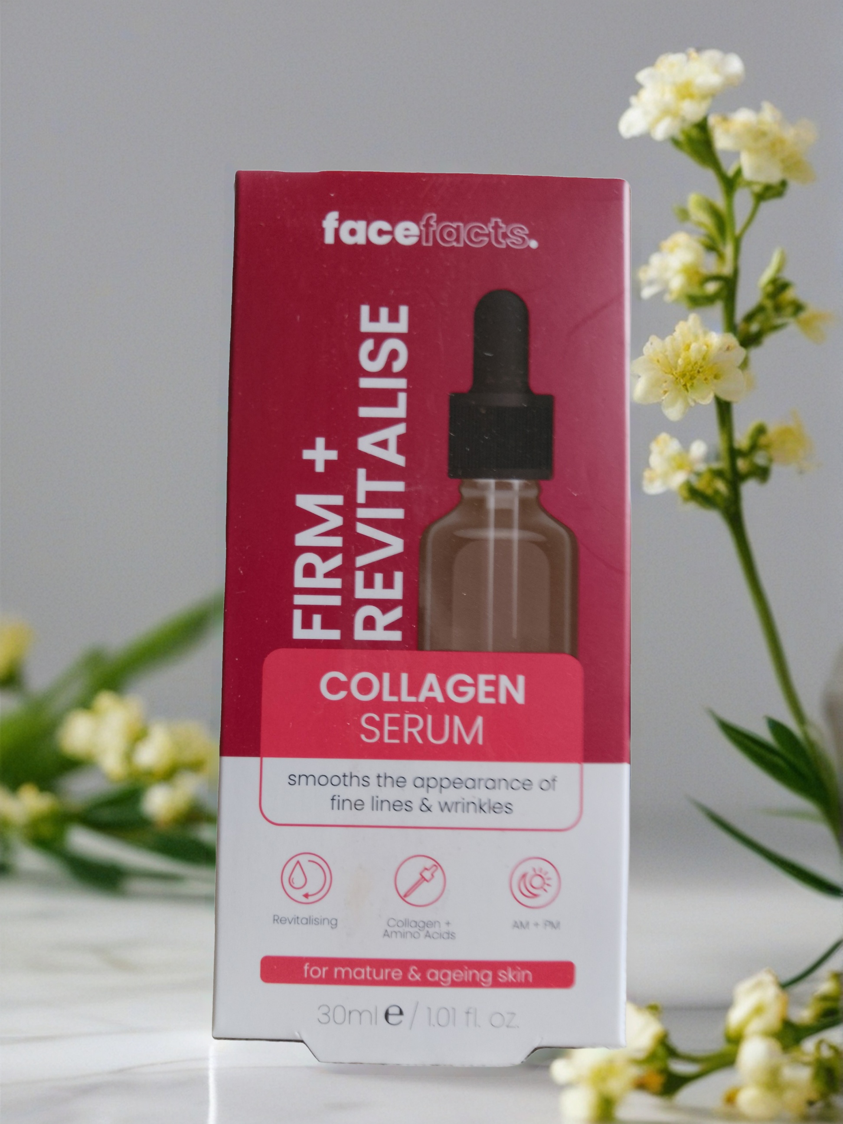
Events & Groups
Great Products For You
Greatproductsvivamknetwork
Book an event online to receive information on products, recruitment and company news.
Join my group and become a member to stay updated.
Dog Splash Pool
VivaMK Collagen
Fridge/Freezer De-Icer
FaceFacts Collagen Serum
This Sprinkler Splash Pool is perfect for cooling your pet down in the hot summer months. Connects easily to a garden hose attachment and folds away for easy storage. Comes boxed. PVC. Diam: 100cm approx.
VivaMK Collagen 60 Capsules
Marine Fish Type
Fridge Freezer De-icer 400ml Aerosol for fast removal of iced up areas
Packed with collagen, betaine & ubiquinone (Q10), this serum is an awesome antioxidant and helps reduce the visibility of fine lines, whilst making your skin soft, smooth and lovely. Vegan. 30ml.

Slide 7
Screenshot
Free Computer/Mobile Classe
Great Products For You
Local, at home, online
Pay Digital
Book a class for mobile/computer and become cash free.

Slide 8
Thank you!
Margit Enzenmuller
Phone number:
01483 456 098
Email address:
margit@greatproductsforyou.co.uk
Website:
www.greatproductsforyou.co.uk
www.greatproductsvivamknetwork.co.uk
greatproducts.vivamknetwork.co.uk

